Slide 1
U-NET, SEGNET, MASK-RCNN

Slide 2
Instance Segmentation
Instance segmentation combines:
Object Detection
Semantic Segmentation
It not only identifies what object exists but also separates each object instance independently.

Slide 3
What is Mask R-CNN?
Mask R-CNN is an advanced deep learning architecture used for instance segmentation.
It can detect objects, classify them, draw bounding boxes, and generate precise segmentation masks for each individual object.
Evolution of Mask R-CNN
Mask R-CNN is an extension of Faster R-CNN.
Faster R-CNN:
Detects objects
Generates bounding boxes
Mask R-CNN:
Detects objects
Generates bounding boxes
Creates segmentation masks

Slide 4
Why Mask R-CNN is Important
Mask R-CNN is important because it identifies both the exact location and shape of each object.
For example, if five people appear in an image, Mask R-CNN can detect all five separately and generate unique masks for each one.

Slide 5
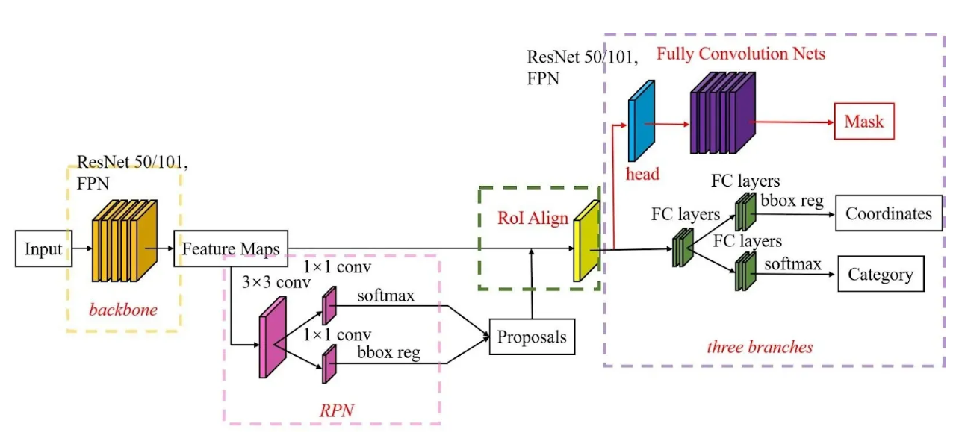

Slide 6
Overall Architecture of Mask R-CNN
The architecture consists of:
Backbone Network
Feature Pyramid Network (FPN)
Region Proposal Network (RPN)
ROI Align
Three Parallel Branches
Together these components enable accurate object detection and segmentation.

Slide 7
Backbone Network
The backbone network extracts image features.
Common backbones include:
ResNet50
ResNet101
The backbone learns:
Edges
Shapes
Textures
Complex object patterns

Slide 8
Feature Pyramid Network (FPN)
Objects in images appear at different sizes.
FPN helps detect:
Small objects
Medium objects
Large objects
It creates feature maps at multiple scales for better detection accuracy.

Slide 9
Region Proposal Network (RPN)
The Region Proposal Network predicts where objects are likely to exist.
These predicted areas are called: Regions of Interest (ROIs)
Instead of scanning the whole image randomly, the model focuses on important regions.

Slide 10
Example of RPN
Suppose an image contains:
Three people
Two cars
One bicycle
The RPN first identifies possible object locations before detailed analysis begins.

Slide 11
ROI Pooling Problem
Earlier models used ROI Pooling.
Problem:
Rounding errors occurred
Object boundaries became misaligned
Segmentation accuracy decreased
This created challenges in precise mask generation.

Slide 12
ROI Align
Mask R-CNN introduced ROI Align.
ROI Align preserves exact spatial information without rounding.
Benefits:
Better localization
Sharper boundaries
More accurate segmentation masks

Slide 13
Three Parallel Branches
After ROI Align, Mask R-CNN divides processing into three branches:
Classification Branch
Bounding Box Regression Branch
Mask Prediction Branch
These tasks are performed simultaneously.

Slide 14
Classification Branch
This branch predicts the category of the object.
Examples:
Person
Car
Bicycle
Dog
Building
It determines what object exists.

Slide 15
Bounding Box Regression Branch
This branch improves object localization.
It adjusts bounding box coordinates to fit the object more accurately.
Result: More precise object detection.

Slide 16
Mask Prediction Branch
This branch generates segmentation masks.
Each detected object receives:
A separate mask
Pixel-level identification
This is the key feature of Mask R-CNN

Slide 17
Training Mask R-CNN
Mask R-CNN uses a multi-task loss function.
It combines:
Classification Loss
Bounding Box Loss
Mask Loss
The model learns all three tasks simultaneously.

Slide 18
Advantages of Mask R-CNN
Major advantages include:
Highly accurate segmentation
Individual object separation
Precise localization
Works well with overlapping objects
Multi-task learning

